Slide 1
ODAA Workshop
December 2012
Charles Duchesne, DSS
Tiffany Snyder, DSS
Jon Snyder, Lockheed Martin

Slide 2
Objectives
C&A Lifecycle
Certification & Accreditation
ISSM Certification
Self Certification
IS Disestablishment
Waiver, Variance& Risk Letters
Examples
POA&M
Hands On Lab

Slide 3
Certification and Accreditation

Slide 4
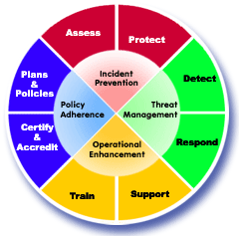
C&A Lifecycle
Certification and Accreditation Lifecycle
What must be Accredited
Systems Security Plan (SSP)
Plan types
Information System Security Manager (ISSM) Certification
Steps/documentation required
Automated tools
(M)SSP Submission
ODAA Email

Slide 5
C&A Lifecycle
Interim Approval to Operate (IATO)
Reasons for IATO denial
ODAA Review
DSS ISSP On-Site Review
Approval to Operate
Tracking IATO’s and ATO’s
Reaccreditation
Self-Certification
Requirement for an ISSM
General Guidelines
Disestablishment of IS

Slide 6
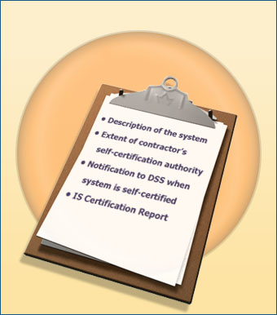
Certification and Accreditation
ISSM Certification
Essential part of the IS life cycle.
Attest that the protection measures described in the plan are implemented and functioning correctly
Certification of: ISSM System Certification Test Checklist.pdf
Physical Area Safeguards
User Training
Hardware
Software
Labeling
Each Operating System that resides on the IS
Notes:
-Seal of approval attest that everything is functioning properly
-Revision # aligns with revision log date for certification

Slide 7
Certification and Accreditation
Self-Certifications
The need for Self-Certification shall be reviewed on an annual basis
Requirements
Successful completion of the NISPOM Chapter 8 course
Facility must have a Satisfactory rating from the previous DSS annual review. Or if a lower rating is received, finding are not the result of the AIS program
Written recommendation from contractor management
Notes:
Table for self-certification
ATO will state self-cert approval
WAN system self-cert no
WAN node self-cert yes
Similar Systems
Self-certified compliant before adding RAL request
Trusted Downloading
Test Equipment

Slide 8
Certification and Accreditation
ISSM’s Self-Certification can be rescinded by:
Recommendation from the contractor management
Two or more serious IS-related findings at the most recent annual review
General guidelines for Self-Certification
MSSP is the vehicle used for self-certifications
Separate MSSP must be written for each classification level of processing
Caveat information does not require a separate MSSP
Each environment requires a separate MSSP e.g. Multi-user Standalone, Domain Controlled, Peer-to-Peer
Notes:
OS are environment aligned

Slide 9
Certification and Accreditation
Self-Certification is not granted under an IATO
Based on similar systems and environments
Self-Certification will be identified through a current ATO letter
Self-Certified system must be properly identified and review by DSS during the next vulnerability assessment
Notification of self-certified systems must be made to ISSP/ISR
Systems with variances cannot be self-certified
ISSM cannot self-certify a WAN system but can self-certify a WAN node

Slide 10
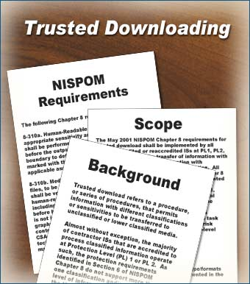
Certification and Accreditation
Non-compliant systems cannot be self-certified
Variations e.g. Alternate Trusted Download Procedures maybe approved after a compliant system is self-certified
Test equipment must be same make and model
Recommend that a comprehensive list of all test equipment to include manufacturer, nomenclature, model, type and amount of memory, and clearing and sanitization procedures for each piece of equipment use at the facility be developed and submitted to DSS.

Slide 11
Certification and Accreditation
IS Disestablishment
End of Contract or program
Media and memory must be sanitized using approved procedures, destroyed or disposed of in accordance with program requirements
Record and logs associated with the IS must be retained for one review cycle
Systems not in use for more than 90 should be considered for disestablishment
ISSM submits a signed letter to the ISSP/ISR stating the reason for the disestablishment and the disposition of the hard drive (s) and media
Notes:
DSS should provide disestablishment return letter

Slide 12
Waiver, Variance & Risk Letters

Slide 13
Definitions
Variance - difference between what is expected by NISPOM requirements and what actually occurs
Waiver- approval document that provides relief from a NISPOM requirement
Risk Acceptance Letter (RAL)- Government Cognizant Authority letter that accepts all residual risk for the variance(s)

Slide 14
RAL Documents
GCA accepts all residual risk for the variance
Typically needed for relief for:
Variances to Chapter 8 technical requirements
Legacy systems (Windows 95/98, Solaris 5.1, HP-UX)
Special purpose, tactical, embedded systems
Technical logon and authentication controls (not implemented)
Alternate trusted download procedures
RAL must be included with the security profile submission
ISSM cannot self certify systems operating under RAL (i.e. with variances to NISPOM requirements)
A new RAL must be generated after 3 years

Slide 15
RAL Requirements
Letter published on GCA letterhead
Reference applicable requirements that are not met
State the reason for the variance
Describe mitigation for the variance
GCA must state the approach is necessary
The GCA must acknowledge there is a risk in not meeting NISPOM requirements
The GCA must accept all residual risk for not meeting NISPOM requirements

Slide 16
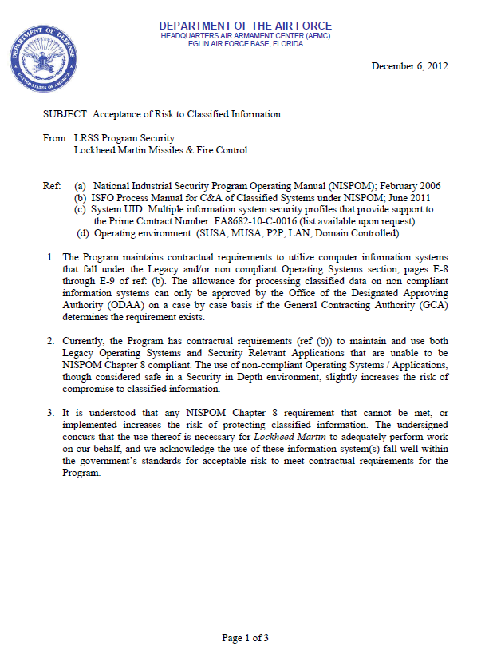
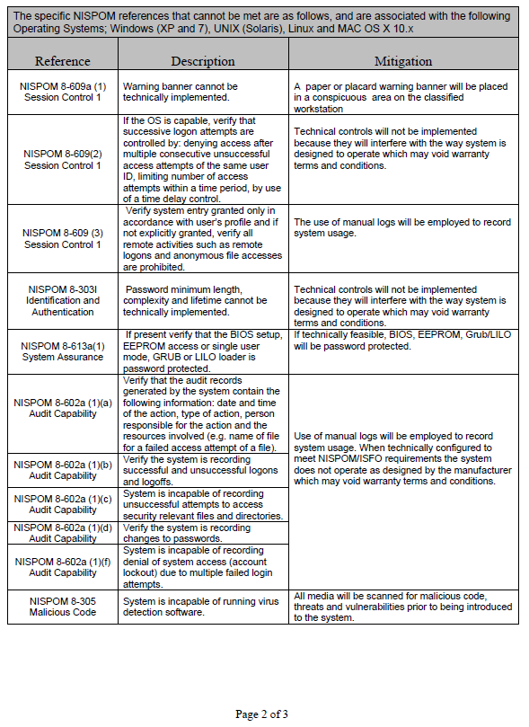
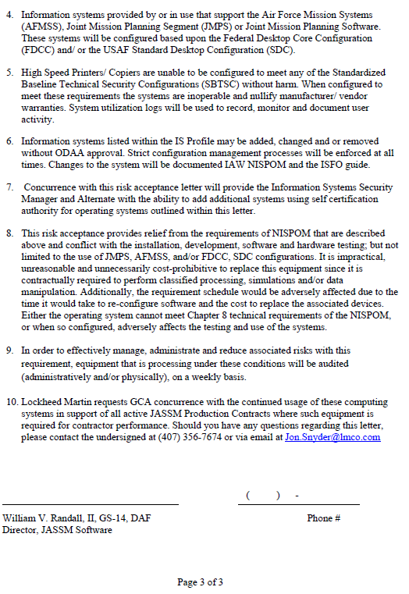
Example RAL

Slide 17
Plan of Action & Milestone (POA&M)
A “get well” plan for systems that do not meet technical requirements
Identify if non-compliance was found during C&A activities or an inspection
Determine risk level from non-compliance
Low- 365 days to be compliant
Medium- 180 days to be compliant
High- 90 days to be compliant
Items are closed when validated by DSS
GCA must approve all non-compliant settings due to program compatibility or contract requirements

Slide 18
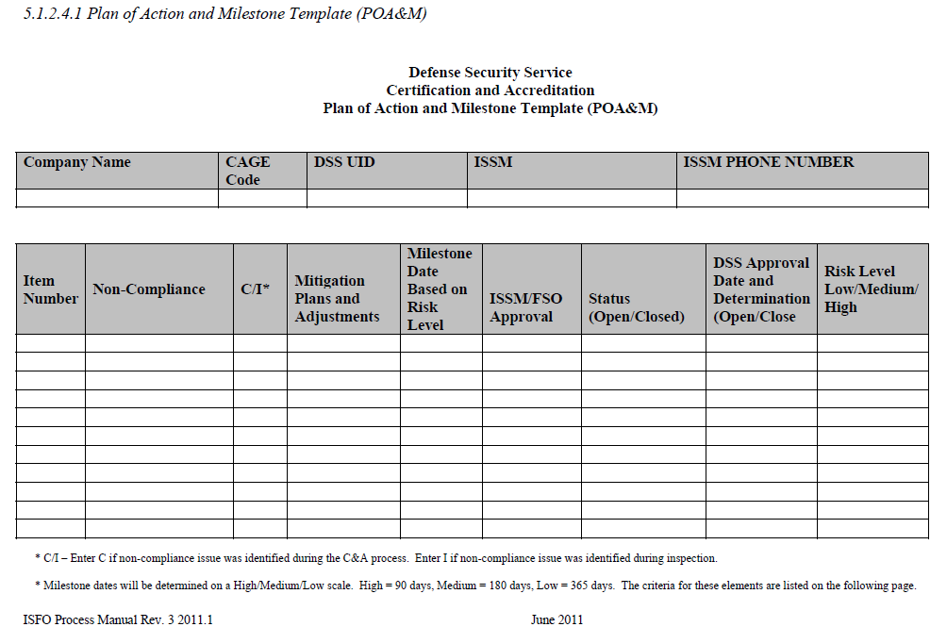
POA&M Template

Slide 19
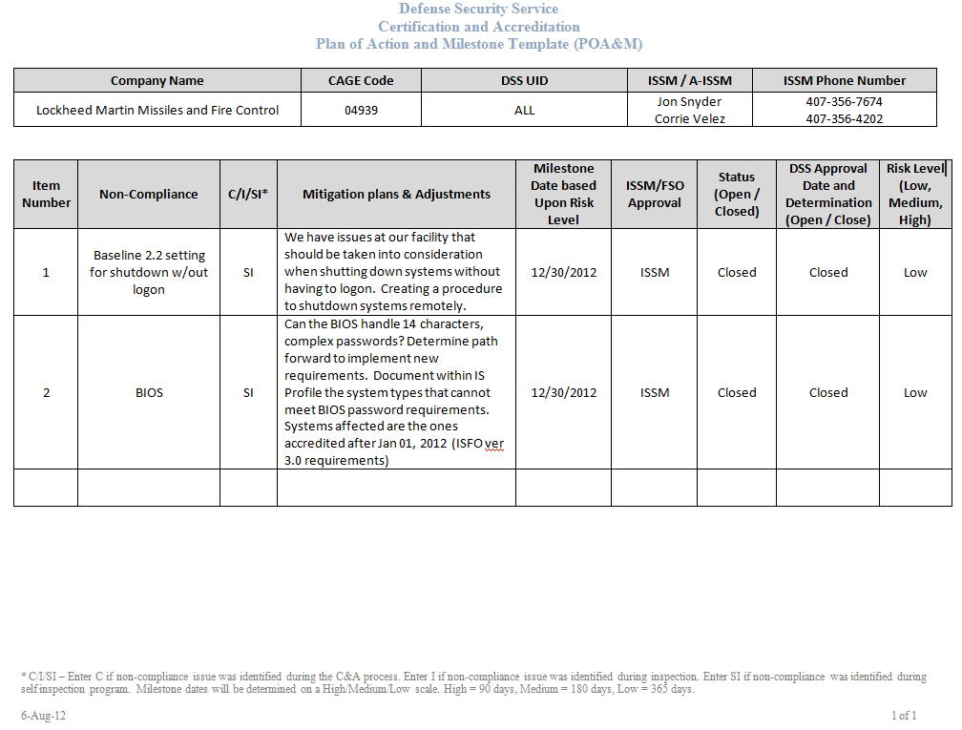
POA&M Example

Slide 20
Variance Approval Request
Approved by the RDAA of that region
Typically used for:
Auditing variance for holiday shutdown
Alternate auditing procedures- infrequently used systems or non-automated auditing systems
For holiday shutdown, system must be accredited or self-certified already
For alternate auditing procedures, the ISSM may include the procedure in the profile submission
ISSM can still self-certify with this type of variance approval

Slide 21
Variance Approval Request Requirements
Letter published on company letterhead addressed to the ISSP
Holiday Shutdown
Identify physical security measures that preclude access
Systems must be audited can checked for tampering upon return
Should be submitted weeks in advance
Alternate Auditing Procedures
Identify physical security measures that preclude access
Identify supplemental logs (ie. Safe logs, seals)

Slide 22
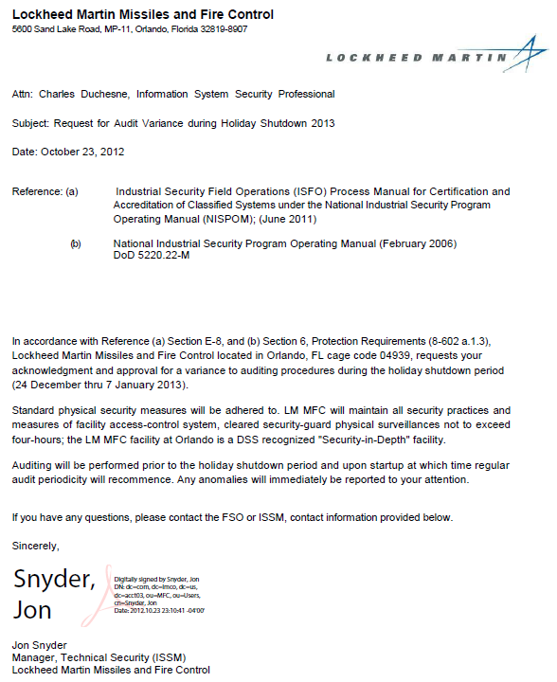
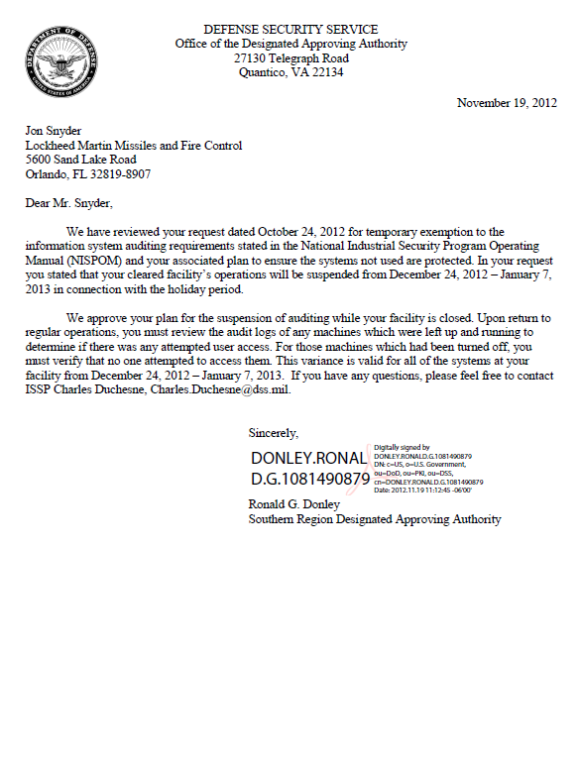
Example Variance Request Letter

Slide 23
DSS Waiver
Can be challenging to obtain
Submitted to ISSP, then to DSS Field Office Chief for review
Forwarded through to DSS/ODAA senior management
May be approved by:
DSS Director
Approval of waivers related to NISPOM
Must be for a single contractor and for a specific timeframe
Deputy Under Secretary of Defense (DUSD)
Broad Application (multiple contractor facilities)
International Issues or related for FGI
Typically not used for chapter 8 requirements

Slide 24
DSS Waiver Requirements
Identify NISPOM paragraph and reason for not being able to meet the requirement
Statement of criticality
Description of information or material requiring protection to include classification and caveats
Description of physical area
Copies of agreements and/or procedures relating to the requirement
The contractor’s proposed alternative to the NISPOM requirement (risk mitigation)
Explain why the alternate countermeasure should be acceptable and identify additional risks

Slide 25
DSS Waiver Sample

Slide 26
Hands On Lab

Slide 27
Hands On Lab
How to certify Windows XP
NISPOM + ISFO version 3 requirements
MUSA, PL1, Restricted Area
NISP tool verification

Slide 28
Questions?

